Slide 1
SC-900T00-A Module 2: Describe the Capabilities of Microsoft Identity and Access Management Solutions

Slide 2
Module Agenda
Explore the services and identity types of Azure Active Directory
Explore the authentication capabilities of Azure Active Directory
Explore the access management capabilities of Azure Active Directory
Describe identity protection governance capabilities of Azure Active Directory
Notes:
Call out that Azure Active Directory and Azure AD are used interchangeably.

Slide 3
Lesson 1: Explore the services and identity types in Azure Active Directory

Slide 4
Lesson 1 Introduction
After completing this module, you’ll be able to:
Describe what is Azure AD
Describe the identity types that Azure AD supports

Slide 5
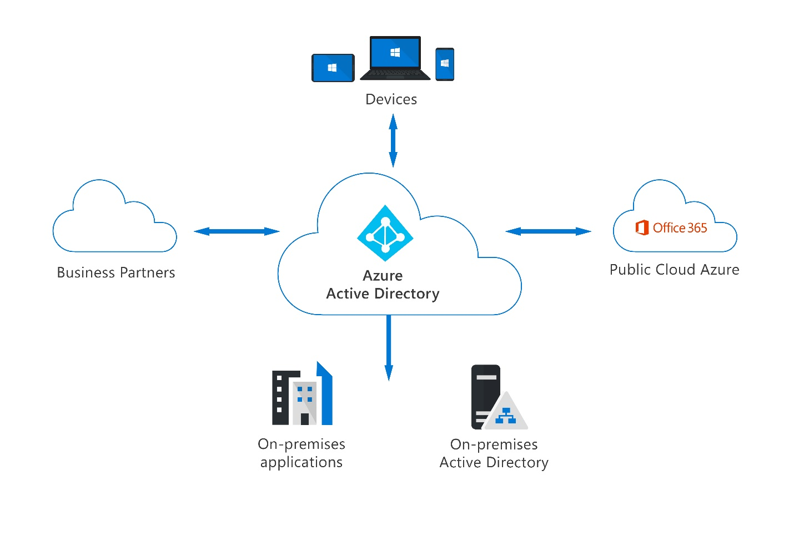
Azure Active Directory
Azure AD is Microsoft’s cloud-based identity and access management service. Capabilities of Azure AD include:
Organizations can enable their employees, guests, and others to sign in and access the resources they need.
Provide a single identity system for their cloud and on-premises applications.
Protect user identities and credentials and to meet an organization’s access governance requirements.
Each Microsoft 365, Office 365, Azure, and Dynamics 365 Online subscription automatically use an Azure AD tenant.
Notes:
Azure Active Directory (Azure AD) is Microsoft’s cloud-based identity and access management service. Organizations use Azure AD to enable their employees, guests, and others to sign in and access the resources they need, including:
Internal resources, such as apps on your corporate network and intranet, and cloud apps developed by your own organization.
External services, such as Microsoft Office 365, the Azure portal, and any SaaS applications used by your organization.
Azure AD simplifies the way organizations manage authorization and access by providing a single identity system for their cloud and on-premises applications. Azure AD can be synchronized with your existing on-premises Active Directory, synchronized with other directory services, or used as a standalone service.
Azure AD also allows organizations to securely enable the use of personal devices, such as mobiles and tablets, and enable collaboration with business partners and customers.
Azure AD is used by IT admins to control access to corporate apps and resources, based on business requirements. It can also be set up to require multi-factor authentication when accessing important organizational resources. Azure AD can be used to automate user provisioning between an existing Windows Server AD and cloud apps, including Microsoft 365. Finally, Azure AD provides powerful tools to automatically help protect user identities and credentials and to meet an organization’s access governance requirements.
Subscribers to Azure services, Microsoft 365, or Dynamics CRM automatically use Azure AD. Each Microsoft 365, Office 365, Azure, or Dynamics CRM Online subscription automatically uses an Azure AD tenant. Users of these services can take advantage of Azure AD services such as self-service password reset, provided it has been configured by their organization’s admins.
Developers use Azure AD as a standards-based approach for adding single sign-on (SSO) to their apps, so that users can sign in with their preexisting credentials. Azure AD also provides APIs that allow developers to build personalized app experiences using existing organizational data.

Slide 6
Azure AD identity types
Azure AD manages different types of identities: users, service principals, managed identities, and devices.
User - a representation of something that's managed by Azure AD. Employees and guests are represented as users in Azure AD.
Service principal - a security identity used by applications or services to access specific Azure resources. You can think of it as an identity for an application.
Managed identity - typically used to manage the credentials for authenticating a cloud application with an Azure service. Two types: system assigned and user assigned.
Device - a piece of hardware, such as mobile devices, laptops, servers, or printer. Device identities can be set up in different ways in Azure AD, to determine properties such as who owns the device.
Notes:
There are several benefits to using managed identities, including:
Application developers can authenticate to services that support managed identities for Azure resources. For a complete list of services, refer to Azure Services that support managed identities .
Any Azure service that supports Azure AD authentication can use managed identities to authenticate to another Azure service; for example, accessing Azure Key Vault.
Managed identities can be used without any extra cost.
There are multiple options for getting devices into Azure AD:
Azure AD registered devices can be Windows 10, iOS, Android, or macOS devices. Devices that are Azure AD registered are typically owned personally, rather than by the organization. They're signed in with a personal Microsoft account or another local account.
Azure AD joined devices exist only in the cloud. Azure AD joined devices are owned by an organization and signed in with their account. Users sign in to their devices with their Azure AD or synced Active Directory work or school accounts. You can configure Azure AD joined devices for all Windows 10 devices (except Windows 10 Home).
Hybrid Azure AD joined devices can be Windows 7, 8.1, or 10, or Windows Server 2008, or newer. Devices that are hybrid Azure AD joined are owned by an organization and signed in with an Active Directory Domain Services account belonging to that organization. They exist in the cloud and on-premises.

Slide 7
Demo
Azure Active Directory user settings
Notes:
Refer to demo script in GitHub

Slide 8
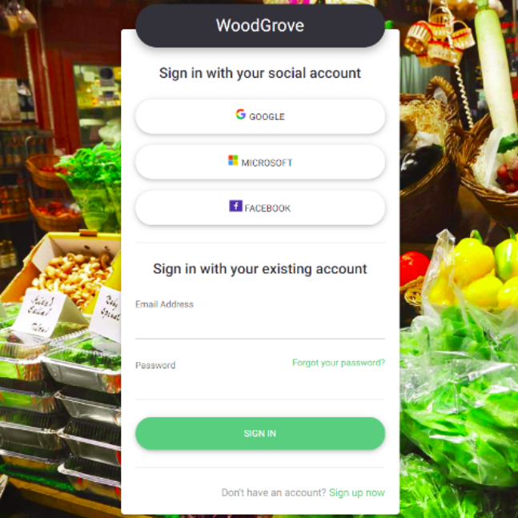
External identities in Azure AD
Two different Azure AD External Identities:
B2B collaboration
B2B collaboration allows you to share your apps and resources with external users
B2C access management
B2C is an identity management solution for consumer and customer facing apps
Notes:
Azure AD External Identities is a set of capabilities that enable organizations to allow access to external users, such as customers or partners. Your customers, partners, and other guest users can "bring their own identities" to sign in.
This ability for external users is enabled through Azure AD support of external identity providers like other Azure AD tenants, Facebook, Google, or enterprise identity providers. Admins can set up federation with identity providers so your external users can sign in with their existing social or enterprise accounts instead of creating a new account just for your application.
There are two different Azure AD External Identities: B2B and B2C.
B2B collaboration allows you to share your apps and resources with external users.
B2C is an identity management solution for consumer and customer facing apps.
B2B collaboration
B2B collaboration allows you to share your organization’s applications and services with guest users from other organizations, while maintaining control over your own data. B2B collaboration uses an invitation and redemption process, allowing external users to access your resources with their credentials. Developers can customize the invitation and redemption process using Azure AD business-to-business APIs.
With B2B collaboration, external users are managed in the same directory as employees but are typically annotated as guest users. Guest users can be managed in the same way as employees, added to the same groups, and so on. With B2B, SSO to all Azure AD-connected apps is supported.
B2C access management
Azure AD B2C is a customer identity access management (CIAM) solution. Azure AD B2C allows external users to sign in with their preferred social, enterprise, or local account identities to get single sign-on to your applications. Azure AD B2C supports millions of users and billions of authentications per day. It takes care of the scaling and safety of the authentication platform, monitoring, and automatically handling threats like denial-of-service, password spray, or brute force attacks.
With Azure AD B2C, external users are managed in the Azure AD B2C directory, separately from the organization's employee and partner directory. SSO to customer owned apps within the Azure AD B2C tenant is also supported.
Azure AD B2C is an authentication solution that you can customize with your brand so that it blends with your web and mobile applications.
Azure AD External Identities is a feature of Premium P1 and P2 Azure AD editions, and pricing is based on Monthly Active Users. For more information, see Azure AD pricing.

Slide 9
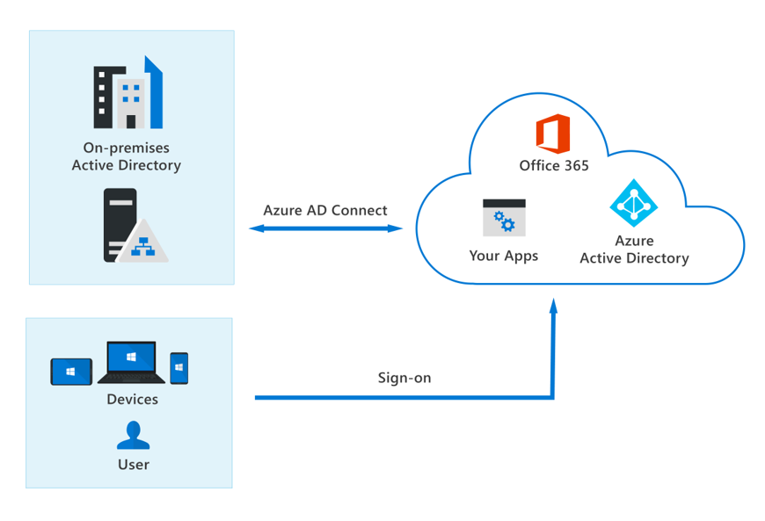
The concept of hybrid identities
Hybrid identities and authentication
Hybrid identity model
With the hybrid model, users accessing both on-premises and cloud apps are hybrid users managed in the on-premises Active Directory.
When you make an update in your on-premises AD DS, all updates to user accounts, groups, and contacts are synchronized to your Azure AD with Azure AD Connect
Methods of authentication
Password hash synchronization
Pass-through authentication (PTA)
Federated authentication
Notes:
Organizations may use the hybrid identity model, or the cloud-only identity model. In the hybrid model, identities are created in Windows Active Directory or another identity provider, and then synchronized to Azure AD. In the cloud-only model, identities are created and wholly managed in Azure AD. Whether identities are created on-premises or in the cloud, users can access both cloud and on-premises resources.
With the hybrid model, users accessing both on-premises and cloud apps are hybrid users managed in the on-premises Active Directory. When you make an update in your on-premises AD DS, all updates to user accounts, groups, and contacts are synchronized to your Azure AD. The synchronization is managed with Azure AD Connect.
When using the hybrid model, authentication can either be done by Azure AD, which is known as managed authentication, or Azure AD redirects the client requesting authentication to another identity provider, which is known as federated authentication.
One of three authentication methods can be used:
Password hash synchronization. The simplest way to enable authentication for on-premises directory objects in Azure AD. Users have the same username and password that they use on-premises without any other infrastructure required.
Pass-through authentication (PTA). Provides a simple password validation for Azure AD authentication services by using a software agent that runs on one or more on-premises servers. The servers validate the users directly with an on-premises Active Directory, which ensures that the password validation doesn't happen in the cloud.
Federated authentication. Azure AD hands off the authentication process to a separate trusted authentication system, such as on-premises Active Directory Federation Services (AD FS), to validate the user’s password.

Slide 10
Lesson 2: Explore the authentication capabilities of Azure Active Directory

Slide 11
Lesson 2 Introduction
After completing this module, you’ll be able to:
Describe the secure authentication methods of Azure AD
Describe the password protection and management capabilities of Azure AD

Slide 12
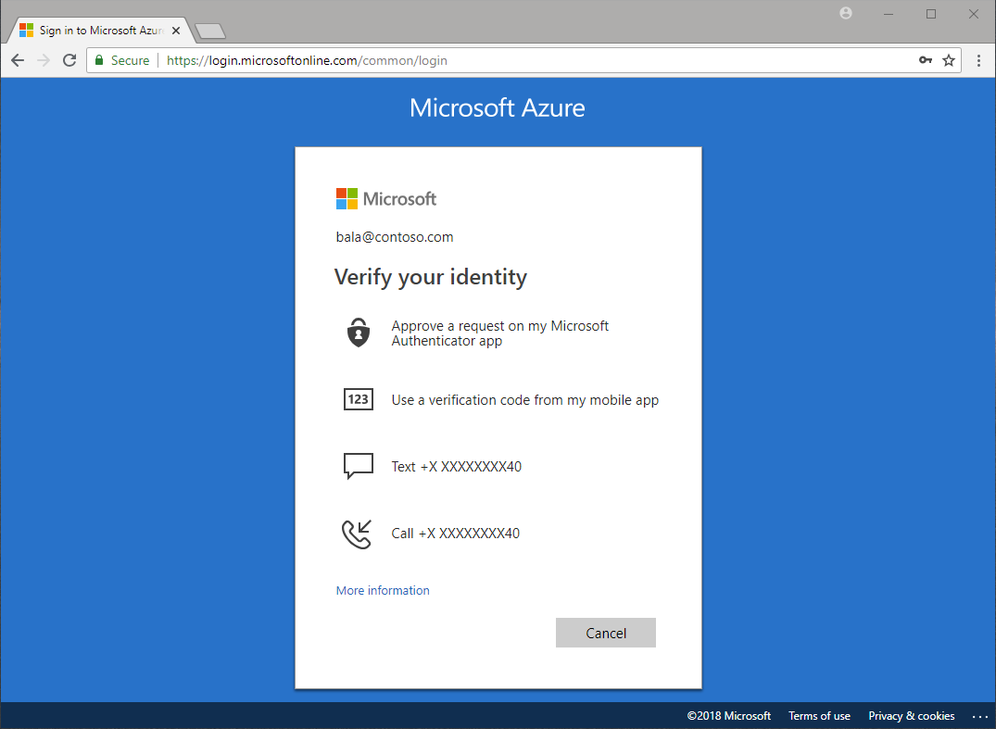
Authentication methods of Azure AD
Multifactor authentication (MFA) & Security Defaults
MFA requires more than one form of verification:
Something you know
Something you have
Something you are
Security defaults:
A set of basic identity security mechanisms recommended by Microsoft.
A great option for organizations that want to increase their security posture but don’t know where to start, or for organizations using the free tier of Azure AD licensing.
Notes:
Legacy applications have relied on a single form of authentication, most often a password. However, passwords are problematic for users, and easily compromised. Multifactor authentication requires more than one form of verification, such as a trusted device or a fingerprint scan, to prove that an identity is legitimate. It means that, even when an identity’s password has been compromised, a hacker can't access a resource.
Multifactor authentication dramatically improves the security of an identity, while still being simple for users. The extra authentication factor must be something that's difficult for an attacker to obtain or duplicate.
The following video explains the problem with passwords, and why multifactor authentication is so important. https://www.microsoft.com/videoplayer/embed/RE4zhD7
Azure Active Directory multifactor authentication works by requiring:
Something you know – typically a password or PIN and
Something you have – such as a trusted device that's not easily duplicated, like a phone or hardware key or
Something you are – biometrics like a fingerprint or face scan.
Multifactor authentication verification prompts are configured to be part of the Azure AD sign-in event. Azure AD automatically requests and processes multifactor authentication, without you making any changes to your applications or services. When a user signs in, they receive a multifactor authentication prompt, and can choose from one of the additional verification forms that they've registered.
An administrator can require certain verification methods, or the user can access their MyAccount to edit or add verification methods.
The following extra forms of verification can be used with Azure Active Directory multifactor authentication:
Microsoft Authenticator app
SMS
Voice call
OATH Hardware token
Security defaults and multifactor authentication
Security defaults are a set of basic identity security mechanisms recommended by Microsoft. When enabled, these recommendations will be automatically enforced in your organization. The goal is to ensure that all organizations have a basic level of security enabled at no extra cost. These defaults enable some of the most common security features and controls, including:
Enforcing Azure Active Directory multifactor authentication registration for all users.
Forcing administrators to use multifactor authentication.
Requiring all users to complete multifactor authentication when needed.
Security defaults are a great option for organizations that want to increase their security posture but don’t know where to start, or for organizations using the free tier of Azure AD licensing. Security defaults may not be appropriate for organizations with Azure AD premium licenses or more complex security requirements.

Slide 13
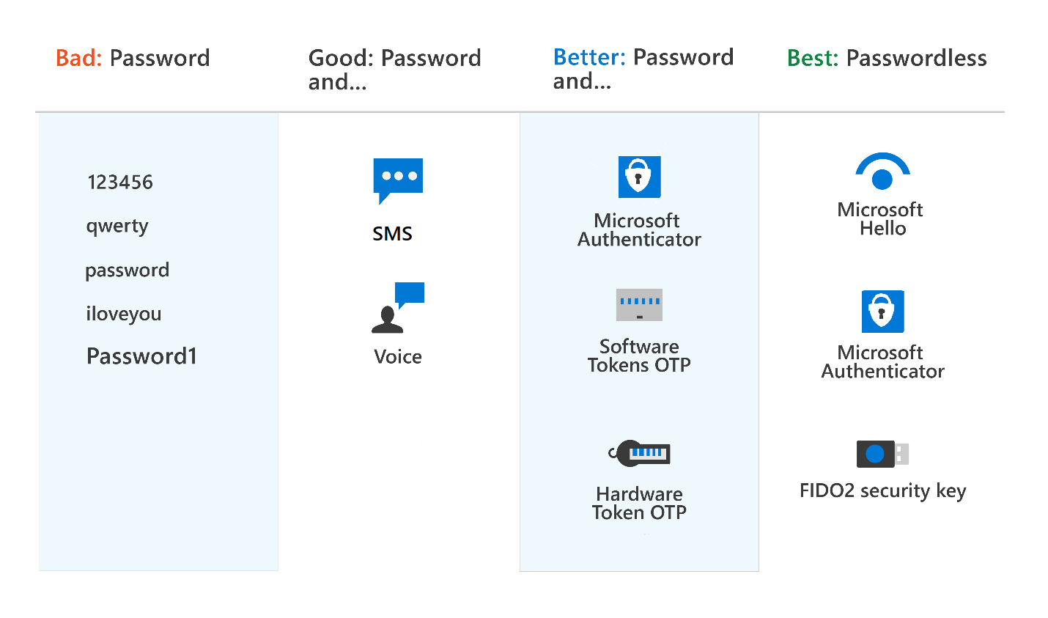
Multi-factor authentication (MFA) in Azure AD
Different authentication methods that can be used with MFA
Passwords
Password & additional verification
Phone (voice or SMS)
Microsoft Authenticator
Open Authentication (OATH) with software or hardware tokens
Passwordless
Biometrics (Windows Hello)
Microsoft Authenticator
FIDO2
Notes:
In this unit, we consider the different authentication methods that can be used with Azure AD multifactor authentication.
Passwords
Passwords have many problems. If they're easy enough to remember, they're easy for a hacker to compromise. Strong passwords that aren't easily hacked are difficult to remember, and affect user productivity when forgotten.
Password and additional verification
With modern authentication and security features in Azure AD, passwords are supplemented or replaced with more secure authentication methods.
Phone
You can also use your phone, configured for either calls or text messages, as an extra means of authentication.
If you set up your extra security verification to receive a phone call, you'll get a call from Microsoft asking you to press a key on your mobile device to verify your identity.
If you set up your additional security verification to receive a text message, you'll be sent a code by text. You then enter the code to verify your identity.
Microsoft Authenticator app
The Microsoft Authenticator phone app allows you to securely verify your identity. The Authenticator app is used to provide the additional information required for two-step or multifactor authentication. Microsoft Authenticator can also be configured to use biometrics, such as a fingerprint or facial scan.
To use Microsoft Authenticator, you must download the phone app from the Microsoft store, and register your account. Microsoft Authenticator is available for Android and iOS. When a user chooses Authenticator as their extra authentication method, a notification is pushed to the phone or tablet. if the notification is legitimate, the user selects Approve, otherwise, they select Deny.
OATH
OATH (Open Authentication) is an open standard that specifies how time-based, one-time password (TOTP) codes are generated. One-time password codes can be used to authenticate a user. OATH TOTP is implemented using either software or hardware to generate the codes.
Software OATH tokens are typically applications such as the Microsoft Authenticator app and other authenticator apps.
OATH TOTP hardware tokens typically come with a secret key, preprogrammed in the token, which must be input into Azure AD. Users are associated with a specific hardware token. The hardware token does a refresh of the code every 30 or 60 seconds.
Passwordless authentication
Passwordless authentication is based on “something you are” rather than “something you know”. A biometric facial scan used in Windows Hello for Business is an example of “something you are”. A fingerprint scan used by the Microsoft Authenticator app or a FIDO2 security device, is also “something you are”.
Passwordless authentication with Azure AD, such as with the Microsoft Authenticator app or FIDO keys, is particularly applicable for shared PCs and where a mobile phone isn't a viable option, such as for help desk personnel, a public kiosk, or a hospital team.
Biometrics
Biometric sign-in uses human characteristics, such as a hand, iris, face, or fingerprint. Windows Hello uses facial or fingerprint biometric data to authenticate a user. You'll learn more about Windows Hello in the next unit. The Microsoft Authenticator app can also be used in passwordless mode, using biometric data such as a fingerprint scan, or a facial scan.
FIDO2 (in preview)
FIDO is an abbreviation for Fast Identity Online, an alliance that promotes open authentication standards and aims to reduce the reliance on passwords as a form of authentication.
Azure AD supports FIDO2, a passwordless authentication method that can come in different forms. FIDO2 allows users to sign in with an external security key. The external key may be a USB device, lightning connector, Bluetooth, or NFC. In whichever form FIDO2 is implemented, the user never has to enter a password.
Users can also register and select a FIDO2 security key as their main means of authentication. Sign-in with FIDO2 security keys is currently in preview in Azure AD.

Slide 14
Windows Hello for Business
Windows Hello lets users authenticate to:
A Microsoft account
An Active Directory account
An Azure Active Directory (Azure AD) account
Identity Provider Services or Relying Party Services that support Fast ID Online v2.0 authentication
Why is Windows Hello safer than a password?
Because it's tied to the specific device on which it was set up. Without the hardware, the PIN is useless
Notes:
Windows Hello, an authentication feature built into Windows 10, replaces passwords with strong two-factor authentication on PCs and mobile devices. This authentication consists of a new type of user credential that's tied to a device and uses a biometric or PIN.
Windows Hello lets users authenticate to:
A Microsoft account.
An Active Directory account.
An Azure Active Directory (Azure AD) account.
Identity Provider Services or Relying Party Services that support Fast ID Online (FIDO) v2.0 authentication (in preview)
After initial verification of the user during enrollment, Windows Hello is set up on their device and Windows asks the user to set a gesture, which can be a biometric, such as a fingerprint, or a PIN. The user provides the gesture to verify their identity. Windows then uses Windows Hello to authenticate them.
Windows stores PIN and biometric data securely on the local device; it's never sent to external devices or servers. That means there's no single collection point that an attacker might compromise.
Why is Windows Hello safer than a password?
Windows Hello in Windows 10 enables users to sign in to their device using a PIN. Although a PIN looks much like a password, a Windows Hello PIN is more secure because it's tied to the specific device on which it was set up. Without the hardware, the PIN is useless.
A regular password is transmitted to a server where it can be intercepted in transmission or stolen from a server. A PIN is local to the device; it isn't transmitted anywhere, and it isn't stored on a server.
The Windows Hello PIN is backed by a Trusted Platform Module (TPM) chip, which is a secure crypto processor that's designed to carry out cryptographic operations. The chip includes multiple physical security mechanisms to make it tamper resistant, and malicious software can't tamper with the security functions of the TPM. Many mobiles phones and modern laptops have TPM.

Slide 15
Self-service password reset (SSPR) in Azure AD
Benefits of Self-service password reset:
It increases security.
It saves the organization money by reducing the number of calls and requests to help desk staff.
It increases productivity, allowing the user to return to work faster.
Self-service password reset works in the following scenarios:
Password change
Password reset
Account unlock
Authentication method of SSPR:
Mobile app notification
Mobile app code
Email
Notes:
Self-service password reset (SSPR) is a feature of Azure AD that allows users to change or reset their password, without administrator or help desk involvement.
If a user's account is locked or they forget the password, they can follow a prompt to reset it and get back to work. Self-service password reset has several benefits:
It increases security, as help desks add an extra security layer.
It saves the organization money by reducing the number of calls and requests to help desk staff.
It increases productivity, allowing the user to return to work faster.
Self-service password reset works in the following scenarios:
Password change: when a user knows their password but wants to change it to something new.
Password reset: when a user can't sign in, such as when they forget the password, and want to reset it.
Account unlock: when a user can't sign in because their account is locked out.
To use self-service password reset, users must be:
Assigned an Azure AD license. See Licensing requirements for Azure Active Directory self-service password reset in the Learn More section below.
Enabled for SSPR by an administrator.
Registered, with the authentication methods they want to use. Two or more authentication methods are recommended in case one is unavailable.
The following authentication methods are available for SSPR:
Mobile app notification
Mobile app code
Email
Mobile phone
Office phone
Security questions
When a user resets their password using self-service password reset, it can also be written back to an on-premises Active Directory. Password write-back allows users to use their updated credentials with on-premises devices and applications without a delay.
To keep users informed about account activity, admins can configure email notifications to be sent when an SSPR event happens. These notifications can cover both regular user accounts and admin accounts. For admin accounts, this notification provides an extra layer of awareness when a privileged administrator account password is reset using SSPR. All global admins would be notified when SSPR is used on an admin account.
available.

Slide 16
Demo
Azure Active Directory
self-service password reset (SSPR)
Notes:
Refer to demo script in GitHub
.

Slide 17
Password protection & management capabilities in Azure AD
Global banned password list
Custom banned password lists
Protecting against password spray
Hybrid security
Notes:
Password Protection is a feature of Azure AD that reduces the risk of users setting weak passwords. Azure AD Password Protection detects and blocks known weak passwords and their variants, and can also block other weak terms that are specific to your organization.
With Azure AD Password Protection, default global banned password lists are automatically applied to all users in an Azure AD tenant. To support your own business and security needs, you can define entries in a custom banned password list. When users change or reset their passwords, these lists are checked to enforce the use of strong passwords.
You should use extra features like Azure Active Directory multifactor authentication, not just rely on strong passwords enforced by Azure AD Password Protection.
Global banned password list
A global banned password list with known weak passwords is automatically updated and enforced by Microsoft. This list is maintained by the Azure AD Identity Protection team, who analyze security telemetry data to find weak or compromised passwords. Examples of passwords that might be blocked are P@$$w0rd or Passw0rd1 and all variations.
Variations are created using an algorithm that transposes text case and letters to numbers such as "1" to an "l". Variations on Password1 might include Passw0rd1, Pass0rd1, and others. These passwords are then checked and added to the global banned password list and made available to all Azure AD users. The global banned password list is automatically applied and can't be disabled.
If an Azure AD user tries to set their password to one of these weak passwords, they receive a notification to choose a more secure one. The global banned list is sourced from real-world, actual password spray attacks. This approach improves the overall security and effectiveness, and the password validation algorithm also uses smart fuzzy-matching techniques. Azure AD Password Protection efficiently detects and blocks millions of the most common weak passwords from being used in your enterprise.
Custom banned password lists
Admins can also create custom banned password lists to support specific business security needs. The custom banned password list prohibits passwords such as the organization name or location. Passwords added to the custom banned password list should be focused on organizational-specific terms such as:
Brand names
Product names
Locations, such as company headquarters
Company-specific internal terms
Abbreviations that have specific company meaning
The custom banned password list is combined with the global banned password list to block variations of all the passwords.
Protecting against password spray
Azure AD Password Protection helps you defend against password spray attacks. Most password spray attacks submit a few of the known weakest passwords against each of the accounts in an enterprise. This technique allows the attacker to quickly search for an easily compromised account and avoid potential detection thresholds.
Azure AD Password Protection efficiently blocks all known weak passwords likely to be used in password spray attacks. This protection is based on real-world security telemetry data from Azure AD, which is used to build the global banned password list.
Hybrid security
For hybrid security, admins can integrate Azure AD Password Protection within an on-premises Active Directory environment. A component installed in the on-premises environment receives the global banned password list and custom password protection policies from Azure AD. Domain controllers then use them to process password change events. This hybrid approach makes sure that, wherever a user changes their password, Azure AD Password Protection is applied.
Although password protection improves the strength of passwords, you should still use best practice features like Azure Active Directory multifactor authentication. Passwords alone, even strong ones, are not as secure as multiple layers of security.

Slide 18
Lesson 3: Explore the access management capabilities of Azure Active Directory

Slide 19
Lesson 3 Introduction
After completing this module, you’ll be able to:
Describe Conditional Access and its benefits
Describe Azure AD roles

Slide 20
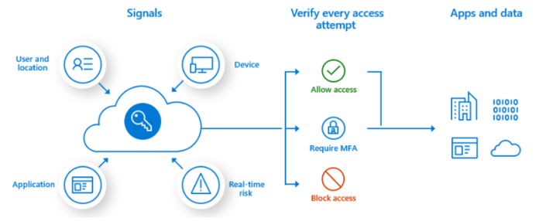
Conditional access
Conditional Access signals:
User or group membership
Named location information
Device
Application
Real-time sign-in risk detection
Cloud apps or actions
User risk
Access controls:
Block access
Grant access
Require one or more conditions to be met before granting access
Control user access based on session controls to enable limited experiences within specific cloud applications
Notes:
Conditional Access is a feature of Azure AD that provides an extra layer of security before allowing authenticated users to access data or other assets. Conditional Access is implemented through policies that are created and managed in Azure AD. A Conditional Access policy analyses signals including user, location, device, application, and risk to automate decisions for authorizing access to resources (apps and data).
A Conditional Access policy might state that if a user belongs to a certain group, then they're required to provide multifactor authentication to sign in to an application.
Watch the video to see how Conditional Access policies work. https://www.microsoft.com/videoplayer/embed/RE4INyI
Conditional Access signals
Conditional Access can use the following signals to control the who, what, and where of the policy:
User or group membership. Policies can be targeted to specific users and groups (including admin roles), giving administrators fine-grained control over access.
Named location information. Named location information can be created using IP address ranges, and used when making policy decisions. Also, administrators can opt to block or allow traffic from an entire country's IP range.
Device. Users with devices of specific platforms or marked with a specific state can be used.
Application. Users attempting to access specific applications can trigger different Conditional Access policies.
Real-time sign-in risk detection. Signals integration with Azure AD Identity Protection allows Conditional Access policies to identify risky sign-in behavior. Policies can then force users to perform password changes or multifactor authentication to reduce their risk level or be blocked from access until an administrator takes manual action.
Cloud apps or actions. Cloud apps or actions can include or exclude cloud applications or user actions that will be subject to the policy.
User risk. For customers with access to Identity Protection, user risk can be evaluated as part of a Conditional Access policy. User risk represents the probability that a given identity or account is compromised. User risk can be configured for high, medium, or low probability.
Access controls
When the Conditional Access policy has been applied, an informed decision is reached on whether to grant access, block access, or require extra verification. Common decisions are:
Block access
Grant access
Require one or more conditions to be met before granting access:
Require multifactor authentication.
Require device to be marked as compliant.
Require hybrid Azure AD joined device.
Require approved client app.
Require app protection policy.
Require password change.
Control user access based on session controls to enable limited experiences within specific cloud applications. As an example, Conditional Access App Control uses signals from Microsoft Cloud App Security (MCAS) to block, download, cut, copy and print sensitive documents, or to require labeling of sensitive files. Other session controls include sign-in frequency and application enforced restrictions that, for selected applications, use the device information to provide users with a limited or full experience, depending on the device state.

Slide 21
Demo
Azure Active Directory Conditional Access
Notes:
Refer to demo script in GitHub
--------
Go to https://portal.azure.com
Demo Conditional Access (Azure AD>Security>Conditional Access)
Some ideas of things to demo:
Demo how to create a new policy (demo the Assignments parameters)
Named location (Countries location and IP ranges location
https://docs.microsoft.com/en-us/azure/active-directory/authentication/tutorial-enable-azure-mfa

Slide 22
Azure AD role-based access control (RBAC)
Azure AD roles control permissions to manage Azure AD resources.
Built-in roles
Custom roles
Azure AD role-based access control
Only grant the access users need
Notes:
Azure AD roles control permissions to manage Azure AD resources. For example, allowing user accounts to be created, or billing information to be viewed. Azure AD supports built-in and custom roles.
Built-in roles
A few of the most common built-in roles are:
Global administrator: users with this role have access to all administrative features in Azure Active Directory. The person who signs up for the Azure Active Directory tenant automatically becomes a global administrator.
User administrator: users with this role can create and manage all aspects of users and groups. This role also includes the ability to manage support tickets and monitor service health.
Billing administrator: users with this role make purchases, manage subscriptions and support tickets, and monitor service health.
There are many built-in roles for different areas of responsibility. All built-in roles are preconfigured bundles of permissions designed for specific tasks.
Custom roles
Although there are many built-in admin roles in Azure AD, custom roles give flexibility when granting access.
Granting permission using custom Azure AD roles is a two-step process that involves creating a custom role definition, consisting of a collection of permissions that you add from a preset list. These permissions are the same ones used in the built-in roles. When you’ve created your role definition, you can assign it to a user by creating a role assignment.
A role assignment grants the user the permissions in a role definition, at a specified scope. A custom role can be assigned at organization-wide scope, meaning the role member has the role permissions over all resources.
A custom role can also be assigned at an object scope. An example of an object scope would be a single application.
Unlike built-in roles, which are assigned at a tenant level and are preconfigured bundles of permissions designed for specific tasks, custom roles can be assigned at the resource level (such as a single application) and allow permissions to be added to a custom role definition.
Custom roles require an Azure AD Premium P1 or P2 license.
Azure AD role-based access control
Managing access using roles is known as role-based access control (RBAC). Azure AD built-in and custom roles are a form of RBAC in that Azure AD roles control access to Azure AD resources.
Only grant the access users need
It's best practice, and more secure, to grant users the least privilege to get their work done. It means that if someone mostly manages users, you should assign the user administrator role, and not global administrator. This mitigates the risk of a user account being compromised, and a hacker locking you out of your account. By assigning least privileges, you limit the damage that could be done with a compromised account.

Slide 23
Lesson 4: Describe the identity protection and governance capabilities of Azure Active Directory

Slide 24
Lesson 4 Introduction
After completing this module, you’ll be able to:
Describe the identity governance capabilities of Azure AD.
Describe the benefits of Privileged Identity Management (PIM).
Describe the capabilities of Azure AD Identity Protection.
Notes:
Identity governance is about balancing identity security with user productivity in a way that can be justified and audited. Azure AD provides many identity protection and governance capabilities, including Privileged Identity Management (PIM), Identity Protection, and terms of use statements.

Slide 25
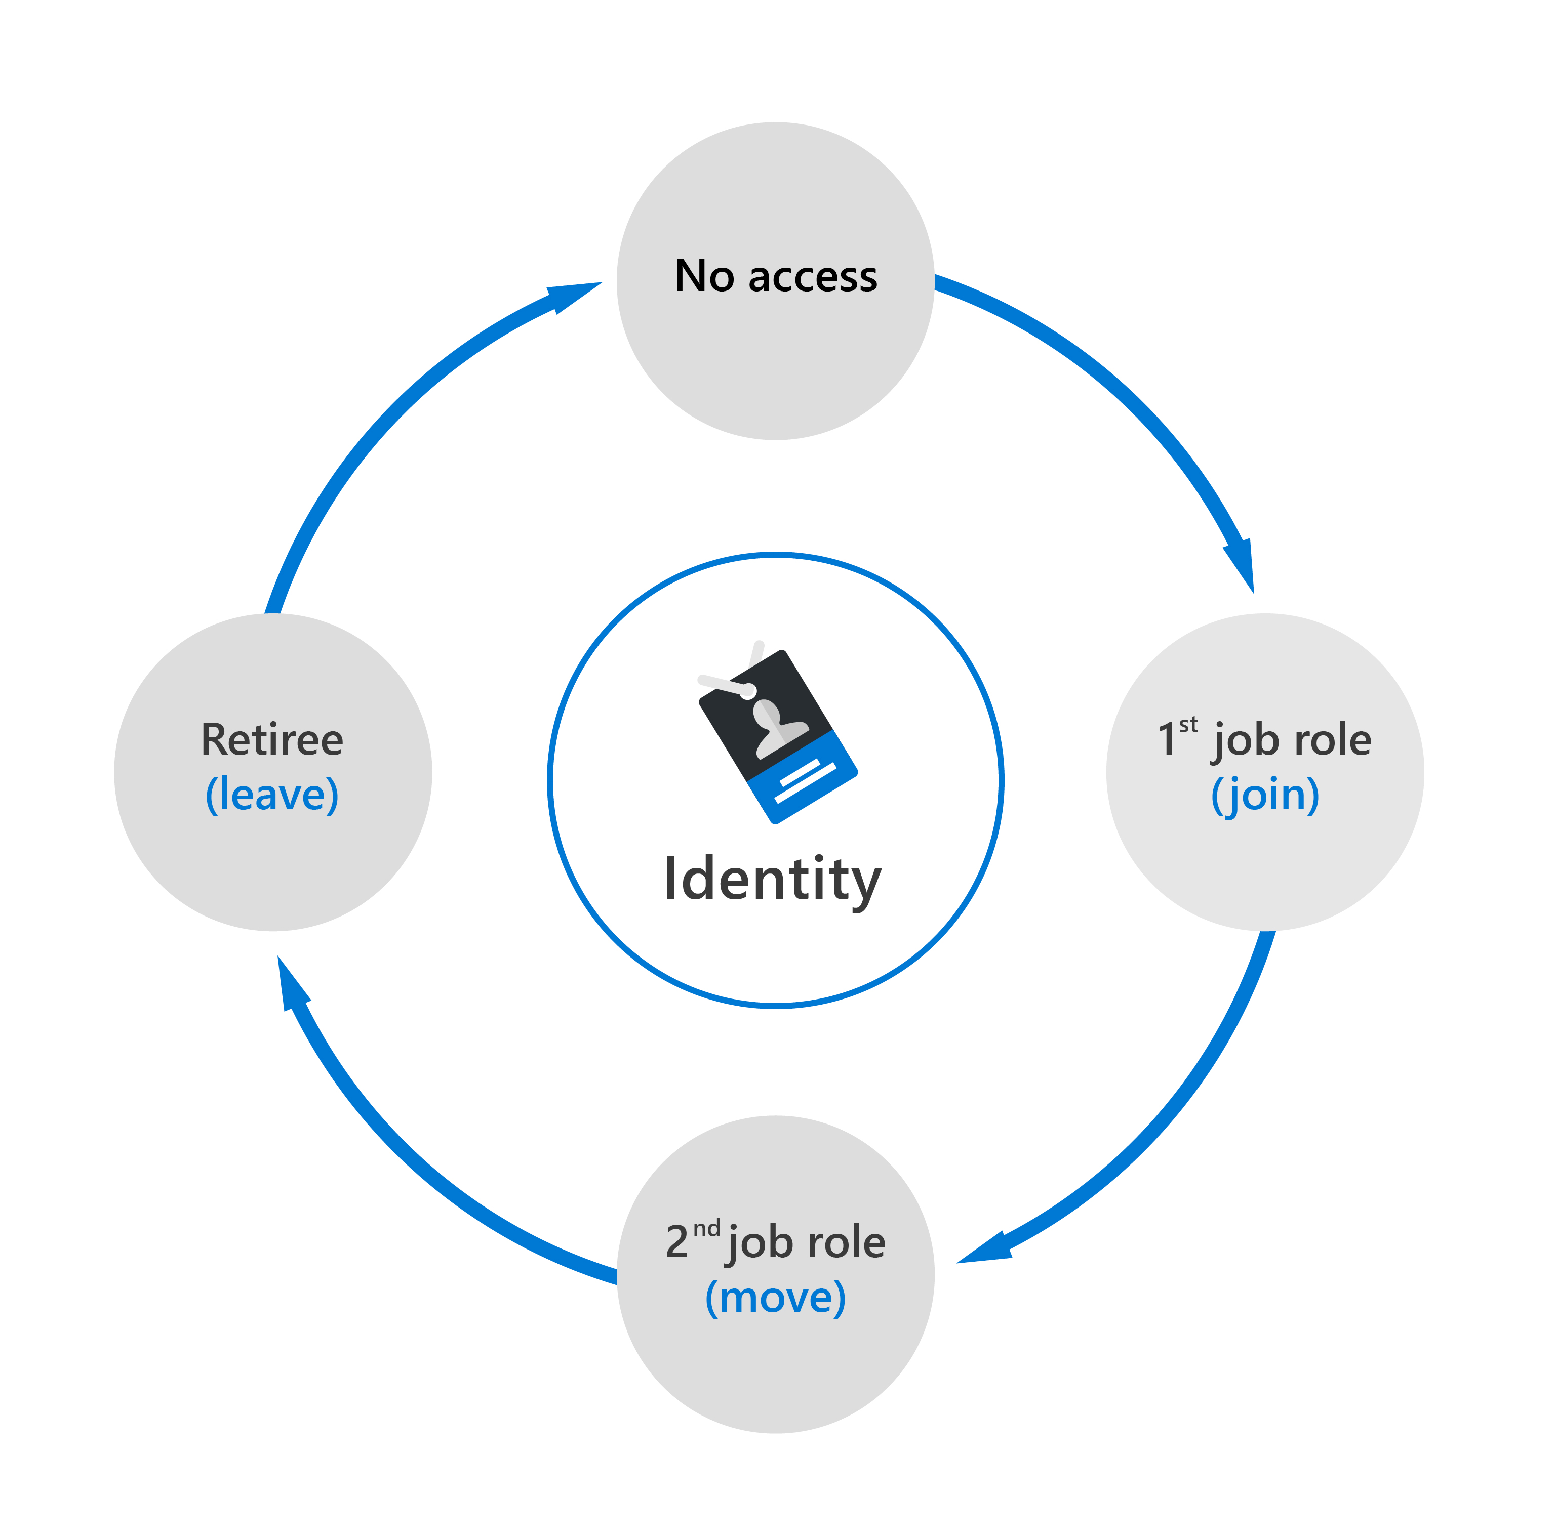
Identity governance in Azure AD
The tasks of Azure AD identity governance
Govern the identity lifecycle.
Govern access lifecycle.
Secure privileged access for administration.
Identity lifecycle
Join: A new digital identity is created.
Move: Update access authorizations.
Leave: Access may need to be removed.
Notes:
Azure AD identity governance gives organizations the ability to do the following tasks:
Govern the identity lifecycle.
Govern access lifecycle.
Secure privileged access for administration.
These actions can be completed for employees, business partners and vendors, and across services and applications, both on-premises and in the cloud.
It's intended to help organizations address these four key questions:
Which users should have access to which resources?
What are those users doing with that access?
Are there effective organizational controls for managing access?
Can auditors verify that the controls are working?
Identity lifecycle
Managing users’ identity lifecycle is at the heart of identity governance.
When planning identity lifecycle management for employees, for example, many organizations model the "join, move, and leave" process. Or, when an individual first joins an organization, a new digital identity is created if one isn't already available. When an individual moves between organizational boundaries, more access authorizations may need to be added or removed to their digital identity. When an individual leaves, access may need to be removed, and the identity might no longer be required, other than for audit purposes.
In general, managing the lifecycle of an identity is about updating the access that users need, whether through integration with an HR system, or through the user provisioning applications.
Access lifecycle
Access lifecycle is the process of managing access throughout the user’s organizational life. Users require different levels of access from the point at which they join an organization to when they leave it. At various stages in between, they'll need access rights to different resources depending on their role and responsibilities.
Organizations can automate the access lifecycle process through technologies such as dynamic groups. Dynamic groups enable admins to create attribute-based rules to determine membership of groups. When any attributes of a user or device change, the system evaluates all dynamic group rules in a directory to see if the change would trigger any users to be added or removed from a group. If a user or device satisfies a rule for a group, they're added as a member of that group. If they no longer satisfy the rule, they're removed.
Privileged access lifecycle
Monitoring privileged access is a key part of identity governance. When employees, vendors, and contractors are assigned administrative rights, there should be a governance process because of the potential for misuse.
Azure AD Privileged Identity Management (PIM), provides extra controls tailored to securing access rights. PIM helps you minimize the number of people who have access to resources across Azure AD, Azure, and other Microsoft online services. PIM provides a comprehensive set of governance controls to help secure your company's resources. PIM is a feature of Azure AD Premium P2.

Slide 26
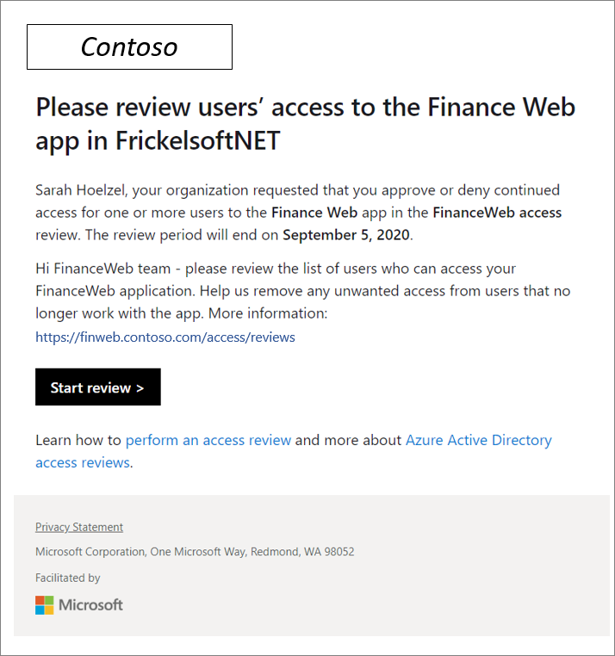
Entitlement management and access reviews
Entitlement management
It is an identity governance feature that enables organizations to manage identity and access lifecycle at scale.
It automates access request workflows, access assignments, reviews, and expiration.
Access reviews
Enable organizations to efficiently manage group memberships, access to enterprise applications, and role assignment.
Ensure that only the right people have access to resources
Used to review and manage access for both users and guests
Terms of use
Allow information to be presented to users, before they access data or an application.
Ensure users read relevant disclaimers for legal or compliance requirements.
Notes:
Entitlement management is an identity governance feature that enables organizations to manage identity and access lifecycle at scale. Entitlement management automates access request workflows, access assignments, reviews, and expiration.
The following video introduces entitlement management and looks at how access packages are used for resources. https://www.microsoft.com/videoplayer/embed/RE4JXQr
Enterprise organizations often face challenges when managing employee access to resources such as:
Users may not know what access they should have, and even if they do, they might have difficulty locating the right individuals to approve it.
When users find and receive access to a resource, they may hold on to access longer than is required for business purposes.
Managing access for external users.
Entitlement management includes the following capabilities to address these challenges:
Delegate the creation of access packages to nonadministrators. These access packages contain resources that users can request. The delegated access package managers then define policies that include rules such as which users can request access, who must approve their access, and when access expires.
Managing external users. When a user who isn't yet in your directory requests access, and is approved, they're automatically invited into your directory and assigned access. When their access expires, if they have no other access package assignments, their B2B account in your directory can be automatically removed.
Entitlement management is a feature of Azure AD Premium P2.
Azure AD access reviews
Azure Active Directory (AD) access reviews enable organizations to efficiently manage group memberships, access to enterprise applications, and role assignment. Regular access reviews ensure that only the right people have access to resources. Excessive access rights are a known security risk. However, when people move between teams, or take on or relinquish responsibilities, access rights can be difficult to control.
Access reviews are helpful when:
You have too many users in privileged roles, such as global administrator.
When automation isn't possible, such as when HR data isn't in Azure AD.
You want to control business critical data access.
Your governance policies require periodic reviews of access permissions.
Access reviews can be created through Azure AD access reviews, or Azure AD Privileged Identity Management (PIM). Access reviews can be used to review and manage access for both users and guests. When an access review is created, it can be set up so that each user reviews their own access, or to have one or more users review everyone's access. Similarly, all guests can be asked to review their own access, or have it looked at by one or more users.
Admins who create access reviews can track progress as the reviewers complete their process. No access rights are changed until the review is finished. You can, however, stop a review before it reaches its scheduled end.
When the review is complete, it can be set to manually or auto-apply changes to remove access from a group membership or application assignment, except for a dynamic group or a group that originates on-premises. In those cases, the changes must be applied directly to the group.
Azure AD terms of use
Azure AD terms of use allow information to be presented to users, before they access data or an application. Terms of use ensure users read relevant disclaimers for legal or compliance requirements.
Employees or guests can be required to accept terms of use in the following situations:
Before they access sensitive data or an application.
On a recurring schedule, so they're reminded of regulations.
When terms of use are required in different languages.
Based on user attributes, such as terms applicable to certain roles.
Presenting terms for all users in your organization.
Terms of use are presented in a PDF format, using content that you create, such as an existing contract document. Terms of use can also be presented to users on mobile devices.
Conditional Access policies are used to require a terms of use statement being displayed, and ensuring the user has agreed to those terms before accessing an application. Admins can then view who has agreed to terms of use, and who has declined.

Slide 27
Privileged Identity Management (PIM)
PIM enables you to manage, control, and monitor access to important resources in your organization.
Just in time, providing privileged access only when needed, and not before.
Time-bound, by assigning start and end dates that indicate when a user can access resources.
Approval-based, requiring specific approval to activate privileges.
Visible, sending notifications when privileged roles are activated.
Auditable, allowing a full access history to be downloaded.
Notes:
Privileged Identity Management (PIM) is a service in Azure Active Directory (Azure AD) that enables you to manage, control, and monitor access to important resources in your organization. These include resources in Azure AD, Azure, and other Microsoft online services such as Microsoft 365 or Microsoft Intune. PIM mitigates the risks of excessive, unnecessary, or misused access permissions. It requires justification to understand why users want permissions and enforces multifactor authentication to activate any role.
PIM is:
Just in time, providing privileged access only when needed, and not before.
Time-bound, by assigning start and end dates that indicate when a user can access resources.
Approval-based, requiring specific approval to activate privileges.
Visible, sending notifications when privileged roles are activated.
Auditable, allowing a full access history to be downloaded.
Privileged Identity Management is a feature of Azure AD Premium P2.
Why use PIM?
PIM reduces the chance of a malicious actor getting access by minimizing the number of people who have access to secure information or resources. By time-limiting authorized users, it reduces the risk of an authorized user inadvertently affecting sensitive resources. PIM also provides oversight for what users are doing with their administrator privileges.
In this video, you'll find out what PIM is, and why you might use it: https://www.microsoft.com/videoplayer/embed/RE4ILbu

Slide 28
Azure Identity Protection
Enables organizations to accomplish three key tasks:
Automate the detection and remediation of identity-based risks.
Investigate risks using data in the portal.
Export risk detection data to third-party utilities for further analysis.
It can categorize and calculate risk:
Categorize risk into three tiers: low, medium, and high.
Calculate the sign-in risk, and user identity risk.
It provides organizations with three reports:
Risky users
Risky sign-ins
Risk detections
Notes:
Identity Protection is a tool that allows organizations to accomplish three key tasks:
Automate the detection and remediation of identity-based risks.
Investigate risks using data in the portal.
Export risk detection data to third-party utilities for further analysis.
Microsoft analyses 6.5 trillion signals per day to identify potential threats. These signals come from learnings Microsoft has acquired from their position in organizations with Azure AD, the consumer space with Microsoft Accounts, and in gaming with Xbox.
The signals generated by these services are fed to Identity Protection. These signals can then be used by tools such as Conditional Access, which uses them to make access decisions. Signals are also fed to security information and event management (SIEM) tools, such as Sentinel, for further investigation.
Identity Protection categorizes risk into three tiers: low, medium, and high. It can also calculate the sign-in risk, and user identity risk.
Sign-in risk is the probability that it wasn’t performed by the user, and uses the following signals to calculate the risk:
Atypical travel. Sign-in from an atypical location based on the user's recent activity.
Anonymous IP address. Sign-in from an anonymous IP address; for example, Tor browser, anonymized VPNs).
User risk is about the probability that their identity has been compromised, and uses the following signals to calculate the risk:
Unfamiliar sign-in properties. Sign-in with properties you've not seen recently for a given user.
Sign-in from a malware-linked IP address.
Leaked credentials. Indicates that the user's valid credentials have been leaked.
Password spray. Indicates that multiple usernames are being attacked using common passwords in a unified, brute-force manner.
Azure AD threat intelligence. Microsoft's internal and external threat intelligence sources have identified a known attack pattern.
These risk signals can trigger actions such as requiring users to provide multifactor authentication, reset their password, or block access until an administrator takes action.
Identity Protection provides organizations with three reports that they can use to investigate identity risks in their environment. These reports are the risky users, risky sign-ins, and risk detections. Investigation of events is key to understanding and identifying any weak points in your security strategy.
After completing an investigation, admins will want to take action to remediate the risk or unblock users. Organizations can also enable automated remediation using their risk policies. Microsoft recommends closing events quickly because time matters when working with risk.
Identity Protection is a feature of Azure AD Premium P2.

Slide 29
Module Summary
In this module, you have:
Learned about Azure AD and services and identity types Azure AD supports
Explore the authentication capabilities of Azure AD, including MFA
Explore the access management capabilities of Azure AD with Conditional Access and Azure AD RBAC
Describe identity protection and governance capabilities of Azure AD, including PIM, entitlement management, and access reviews.
Learned about the capabilities of Azure AD Identity Protection.

Slide 30
Closing slide

